Slide 1
Blacktown Chinese Christian Church
Welcome to Our English Service 02.11.2025
English Service 9:45 – 11:00 am
Worship Songs: Passage: Speaker: Topic: Response Song: Announcements and Closing Prayer Benediction
Nothing is impossible I give you my heart Goodness of God Heart of worship Acts 4:36-37; Acts 9:26-28 Jose Peter Barnabas TBA

Slide 2
BCCC english service

Slide 3

Please keep all phones on silent

Slide 4
Nothing Is Impossible
CCLI Licence No: 5485849

Slide 5
Through You, I can do anything
I can do all things
For it's You who gives me strength
Nothing is impossible

Slide 6
Through You, blind eyes are opened
Strongholds are broken
I am living by faith
Nothing is impossible

Slide 7
Yeah
Nothing is impossible
Oh-ooh

Slide 8
I'm not gonna live by what I see
I'm not gonna live by what I feel

Slide 9
Deep down I, know that You're here with me (Here with me)
And I know that You can do anything

Slide 10
Through You, I can do anything
I can do all things
For it's You who gives me strength
Nothing is impossible

Slide 11
Through You, blind eyes are opened
Strongholds are broken
I am living by faith
Nothing is impossible

Slide 12
Woah-ooh
Nothing is impossible
Woah-ooh

Slide 13
I'm not gonna live by what I see
No, I'm not gonna live by what I feel

Slide 14
Hey, deep down I, know that You're here with me (Here with me)
And I know that You can do anything

Slide 15
Through You, I can do anything
I can do all things
For it's You who gives me strength
Nothing is impossible

Slide 16
Through You, blind eyes are opened
Strongholds are broken
I am living by faith
Nothing is impossible

Slide 17
Woah-ooh
Nothing is impossible

Slide 18
I believe, I believe
I believe, I believe in You
I believe, I believe
I believe, I believe in You

Slide 19
I believe, I believe
I believe, I believe in You
I believe, I believe
I believe, I believe in You

Slide 20
Through You, I can do anything
I can do all things
For it's You who gives me strength
Nothing is impossible

Slide 21
Through You, blind eyes are opened
Strongholds are broken
I am living by faith
Nothing is impossible

Slide 22
I believe, I believe
I believe, I believe in You
I believe, I believe
I believe, I believe in You

Slide 23
I Give You My Heart
CCLI Licence No: 5485849

Slide 24
This is my desire to honor You
Lord, with all my heart, I worship You
All I have within me, I give You praise
All that I adore is in You

Slide 25
Lord, I give You my heart
I give You my soul, I live for You alone
Every breath that I take, every moment I'm awake
Lord, have Your way in me

Slide 26
This is my desire to honor You
Lord, with all my heart, I worship You
All I have within me, I give You praise
All that I adore is in You

Slide 27
Lord, I give You my heart
I give You my soul, I live for You alone
Every breath that I take, every moment I'm awake
Lord, have Your way in me

Slide 28
And I will live
And I will live for You
And I will live
And I will live for You

Slide 29
Oh and I will live
And I will live
And I will live for You

Slide 30
Lord, I give You my heart
I give You my soul, I live for You alone
Every breath that I take, every moment I'm awake
Lord, have Your way in me

Slide 31
Goodness Of God
CCLI Licence No: 5485849

Slide 32
I love You, Lord
For Your mercy never fails me
All my days, I've been held in Your hands

Slide 33
From the moment that I wake up
Until I lay my head
Oh, I will sing of the goodness of God

Slide 34
All my life You have been faithful
And all my life You have been so, so good
With every breath that I am able
Oh, I will sing of the goodness of God

Slide 35
I love Your voice
You have led me through the fire
And in darkest night You are close like no other

Slide 36
I've known You as a Father
I've known You as a Friend
And I have lived in the goodness of God

Slide 37
All my life You have been faithful
And all my life You have been so, so good
With every breath that I am able
Oh, I will sing of the goodness of God

Slide 38
Your goodness is running after, it's running after me
Your goodness is running after, it's running after me

Slide 39
With my life laid down, I'm surrendered now
I give You everything
Your goodness is running after, it's running after me

Slide 40
Your goodness is running after, it's running after me
Your goodness is running after, it's running after me

Slide 41
With my life laid down, I'm surrendered now
I give You everything
Your goodness is running after, it's running after me

Slide 42
All my life You have been faithful
And all my life You have been so, so good
With every breath that I am able
Oh, I'm gonna sing of the goodness of God

Slide 43
All my life You have been faithful
And all my life You have been so, so good
With every breath that I am able
Oh, I'm gonna sing of the goodness of God

Slide 44
Oh, I'm gonna sing of the goodness of God

Slide 45
The Heart Of Worship
CCLI Licence No: 5485849

Slide 46
When the music fades
All is stripped away
And I simply come

Slide 47
Longing just to bring
Something that's of worth
That will bless Your heart

Slide 48
I'll bring You more than a song
For a song in itself
Is not what You have required

Slide 49
You search much deeper within
Through the way things appear
You're looking into my heart

Slide 50
I'm coming back to the heart of worship
And it's all about You, it's all about You, Jesus
I'm sorry, Lord, for the thing I've made it
When it's all about You, it's all about You, Jesus

Slide 51
King of endless worth
No one could express
How much you deserve

Slide 52
Though I'm weak and poor
All I have is Yours
Every single breath

Slide 53
I'll bring You more than a song
For a song in itself
Is not what You have required

Slide 54
You search much deeper within
Through the way things appear
You're looking into my heart

Slide 55
I'm coming back to the heart of worship
And it's all about You, it's all about You, Jesus
I'm sorry, Lord, for the thing I've made it
When it's all about You, it's all about You, Jesus

Slide 56
I'm coming back to the heart of worship
And it's all about You, it's all about You, Jesus
I'm sorry, Lord, for the thing I've made it
When it's all about You, it's all about You, Jesus

Slide 57
I'll bring you more than a song
I'll bring you more than a song
More than a song

Slide 58
I'll bring you more than a song
I'll bring you more than a song
More than a song

Slide 59
You're looking into my heart,
looking into my heart
You're looking into my heart

Slide 60
You're looking into my heart,
looking into my heart
You're looking into my heart

Slide 61
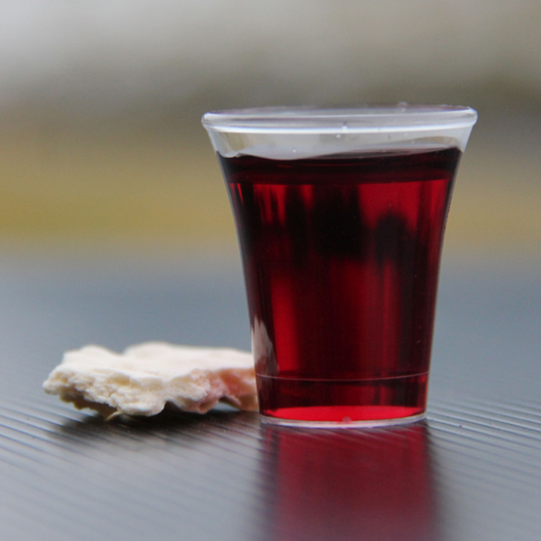
Holy Communion

Slide 62

Bible reading

Slide 63
Acts 4:36-37; Acts 9:26-28
³⁶ Joseph, a Levite from Cyprus, whom the apostles called Barnabas (which means “son of encouragement”), ³⁷ sold a field he owned and brought the money and put it at the apostles’ feet.

Slide 64
Acts 4:36-37; Acts 9:26-28
²⁶ When he came to Jerusalem, he tried to join the disciples, but they were all afraid of him, not believing that he really was a disciple. ²⁷ But Barnabas took him and brought him to the apostles. He told them how Saul on his journey had seen the Lord and that the Lord had spoken to him, and how in Damascus he had preached fearlessly in the name of Jesus.

Slide 65
Acts 4:36-37; Acts 9:26-28
²⁸ So Saul stayed with them and moved about freely in Jerusalem, speaking boldly in the name of the Lord.

Slide 66
Announcements

Slide 67





Account name: Blacktown Chinese Christian Church
Account number: 4216 50263
Offering
BSB: 112 - 879
Please put in "offering" as the reference
The offering box is available at the back of the hall

Slide 68
Prayer points

Slide 69
Mingle time!

